Slide 1
x
f(0,0) | f(1,0) | f(2,0) | f(3,0) | f(4,0)
f(0,1) | f(1,1) | f(2,1) | f(3,1) | f(4,1)
f(0,2) | f(1,2) | f(2,2) | f(3,2) | f(4,2)
f(0,3) | f(1,3) | f(2,3) | f(3,3) | f(4,3)
f(0,4) | f(1,4) | f(2,4) | f(3,4) | f(4,4)
y

Slide 2
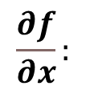
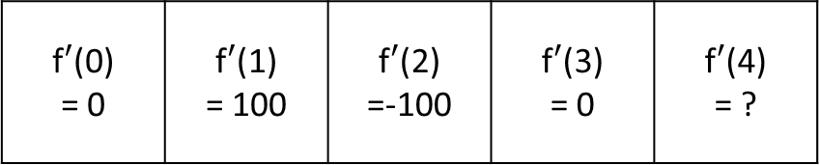

x
f(0) = 100 | f(1) = 100 | f(2) =200 | f(3) = 100 | f(4) = 100
$$f(x):$$
x
f$′$(0) = 0 | f$′$(1) = 100 | f$′$(2) =-100 | f$′$(3) = 0 | f$′$(4) = ?
$$\frac{∂f}{∂x}:$$

